Slide 1

AWS Lambda

Slide 2
AWS Scripts*
Lambda runs your code (currently Node.js (JavaScript), Python, Java (Java 8 compatible), and C# (.NET Core) and Go). Things that you’d typically do with a server (or EC2, ECS, EKS) can instead be broken down into small chunks.
It’s like if you asked AWS to make you a custom computer whose one and only purpose was to execute your code block.
*https://www.expeditedssl.com/aws-lambda-in-plain-english

Slide 3
Comparison of Options
Lambda
Write your f(n)
1M free, $.2 for every additional M
Just write code
Serverless
ECS / EKS
Drop in docker
CPU + Mem = $$
All benefits of container, no VM management
Microservice
EC2
Your Own VM
$3/month (dedicated)
ssh in and go nuts
Monolith

Slide 4
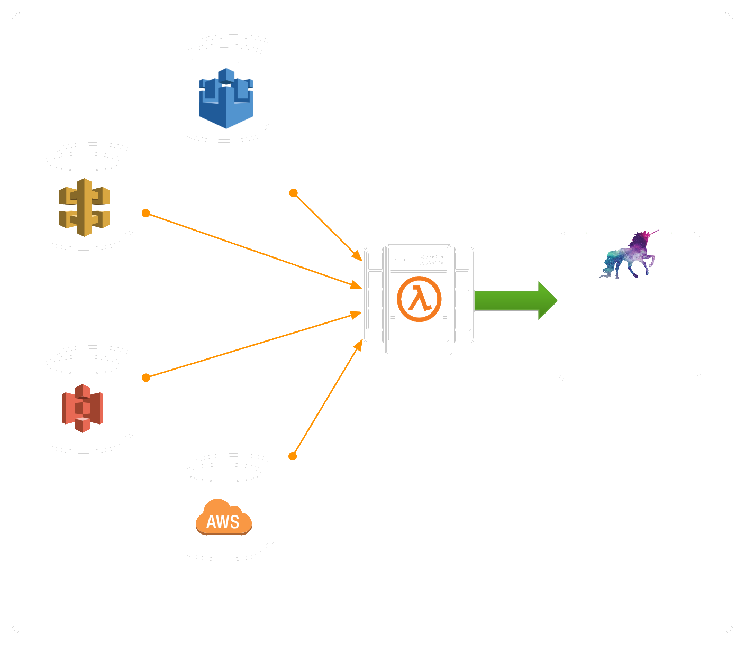
Architecture

Slide 5
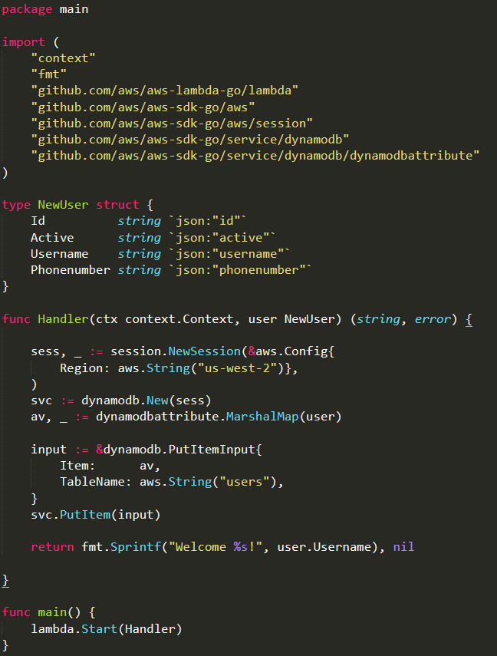
Example (GO)
Lambda’s operate off of handlers
Access to all other AWS Services
Max 300 seconds (default 3)
Stateless

Slide 6
Real World Scenario
YO!

Slide 7

YO!
Build an app backend that does the following
Creates Users
Send a YO to a user
Log that a message was sent

Slide 8
What’s your tech stack brah?!
One team likes Node
One team likes GO
No one wants to pay for multiple hosting environments

Slide 9
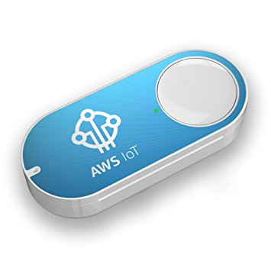


YO! Application

Slide 10

Show me the code
Demo Time

Slide 11
Questions?
https://github.com/jcutrono/aws-lambda

